Slide 1

Health Care
Database
Instructor: Wuping Wang
Team Members:
Zi Wang
Yuting Wu
Yidi Xu
Hongyun Shen

Slide 2
CONTENTS
01
02
03
04
05
Introduction
ERD
SQL Statements
Reporting Views
PowerBI Reports

Slide 3
01
Introduction

Slide 4

Introduction
HealthCare Database
Advantages of HealthCare Database:
Providing accurate, up-to-date, and complete information about patients at the point of care.
Enabling quick access to patient records for more coordinated, efficient care.
Improving patient and provider interaction and communication, as well as health care convenience.
Helping promote legible, complete documentation and accurate, streamlined coding and billing.
Enhancing privacy and security of patient data.
Reducing costs through decreased paperwork, improved safety, reduced duplication of testing, and improved health.

Slide 5
Introduction
Mission Statement :
Our healthcare database will:
Provide patients’ information including past medical records, and allergic history.
Help patients to find out useful real-time information including contact information of provider and their services.
Enable physicians, pharmacists, and others to track prescribed medications and to report adverse drug reactions.
Help providers to find information of particular value in database, to help them improve their services.

Slide 6
Introduction
ERD
Entity-relationship diagram, which is a conceptual and representational model of data used to represent the entity framework infrastructure.
SQL Statements
Views
DDL: Data Definition Language, like Create, Alter, and Drop schema objects
A view is a virtual table based on the result-set of an SQL statement. A view contains rows and columns, just like a real table. The fields in a view are fields from one or more real tables in the database.

Slide 7
02
ERD

Slide 8
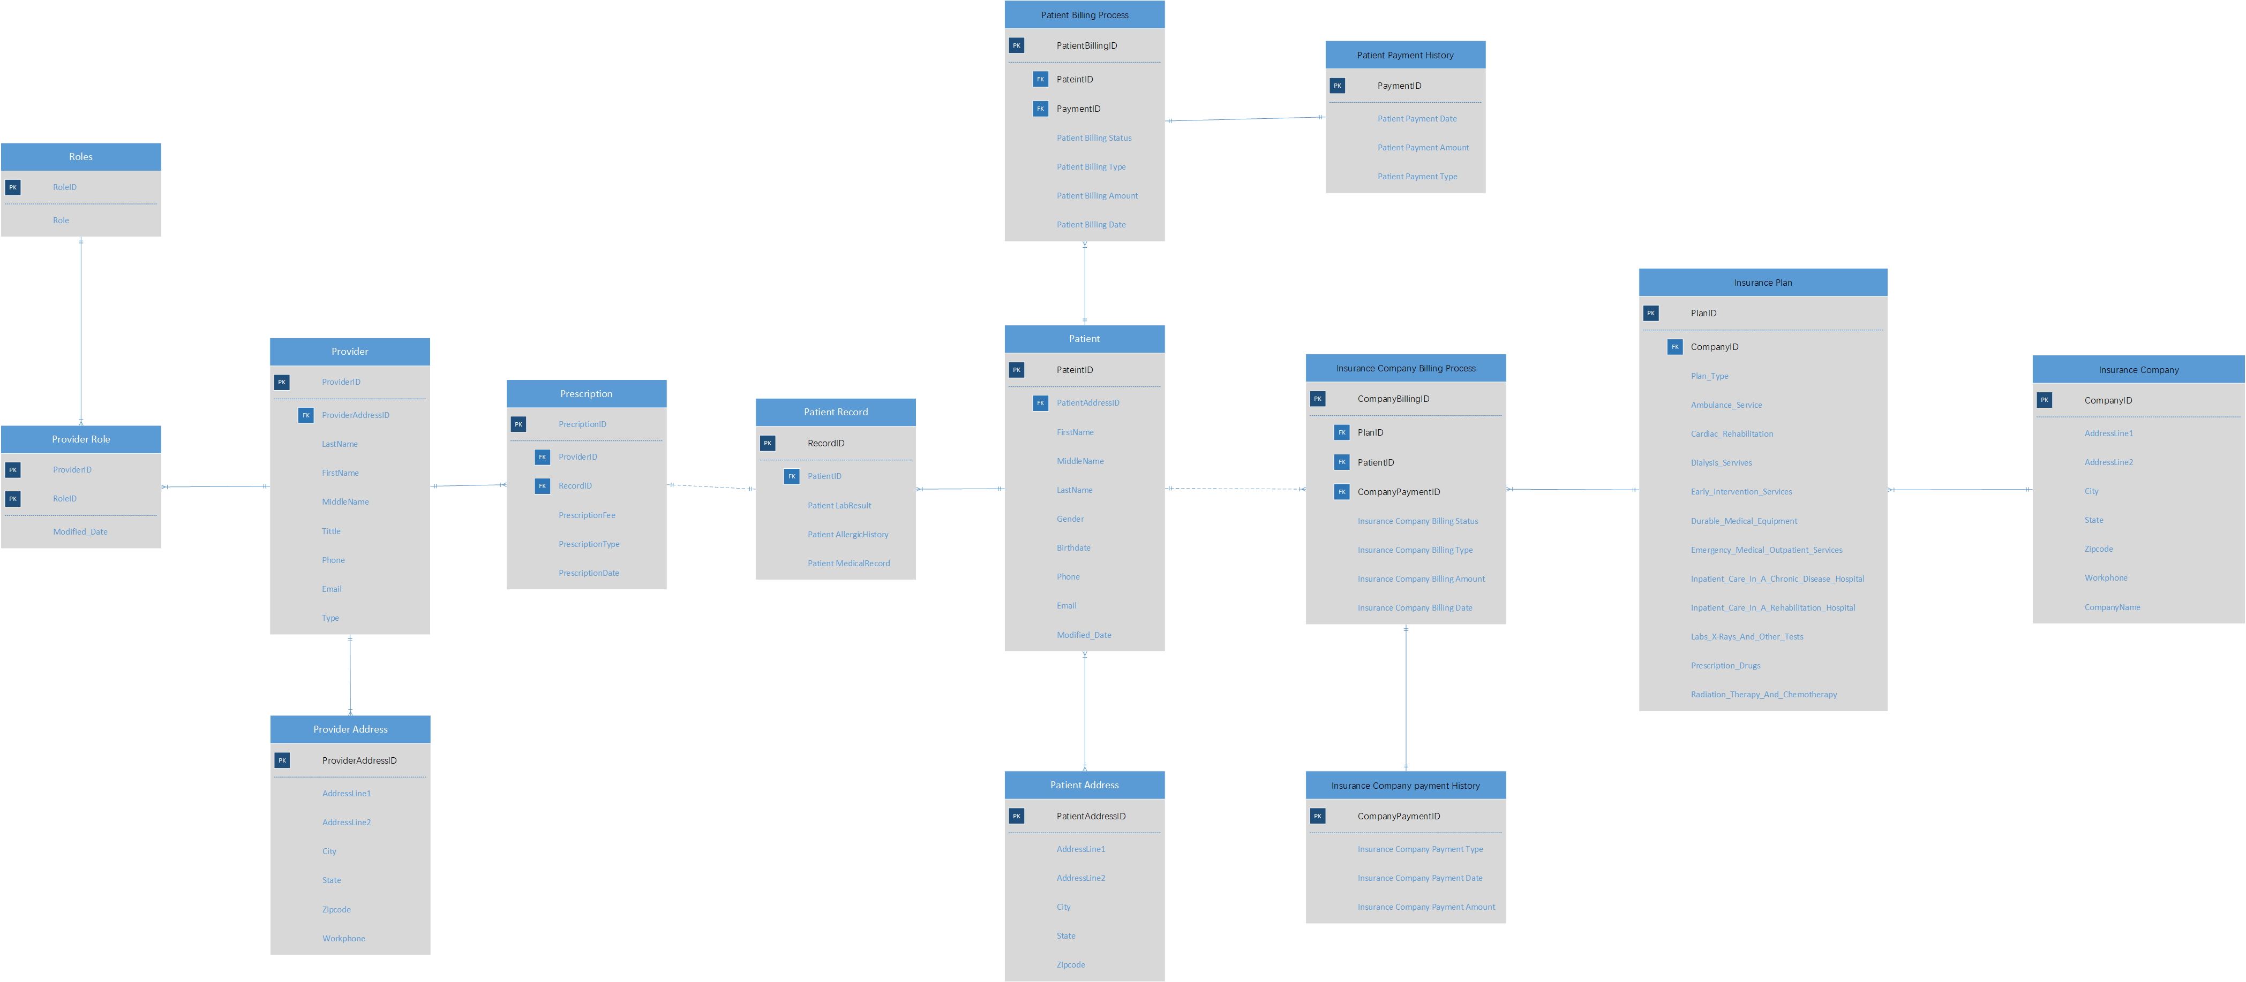
ERD

Slide 9
03
SQL Statements

Slide 10
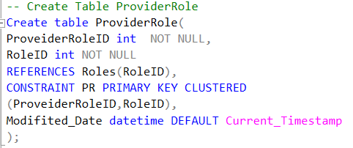
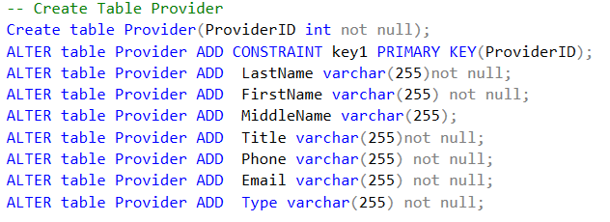
SQL Statements
Create Table with Clustered Primary Key
Create ProviderRole Table with Clustered Primary Key: ProviderRoleID and RoleID.
Create Table using Alter Statements
Create Provider Table using Alter statements: Alter Add Constraint, and Alter Add.

Slide 11
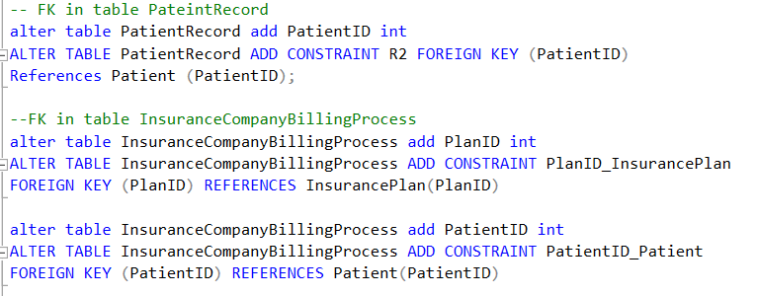
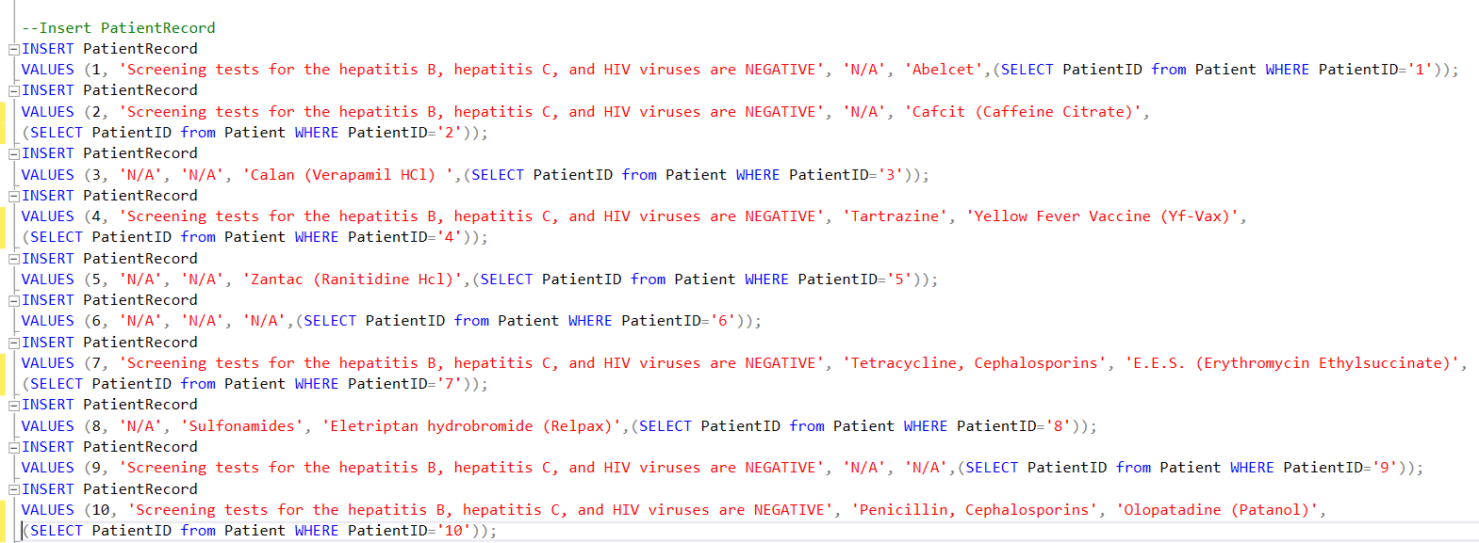
SQL Statements
Add Foreign Key into Tables
Add FK into PatientRecord and InsuranceCompanyBillingProcess Tables using Alter Table Add Constraint Foreign Key References.
Insert date into Tables
Insert date into Table PatientRecord using Insert and Values.

Slide 12
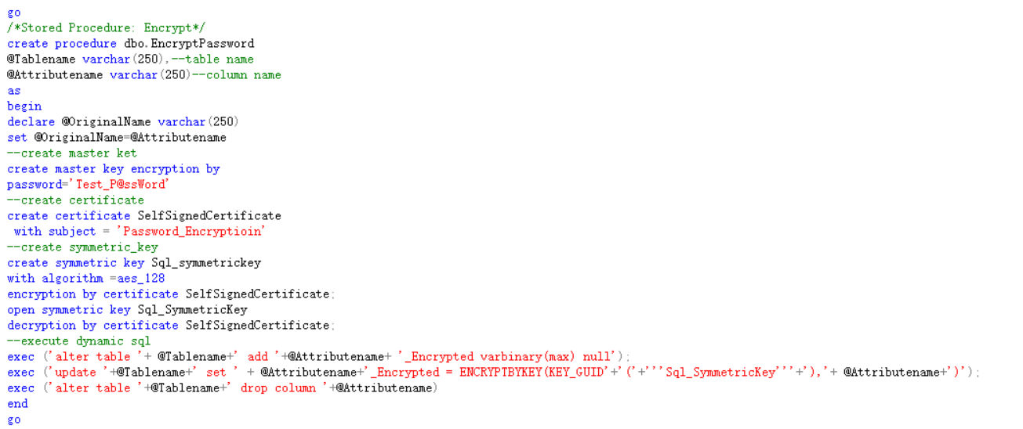
SQL Statements
Table Encryption
Create Table using Alter Statements

Slide 13
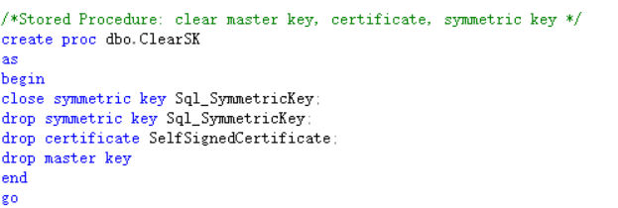
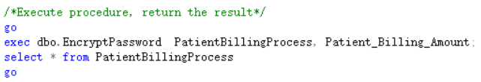
SQL Statements
Stored Procedure
Execute Procedure

Slide 14
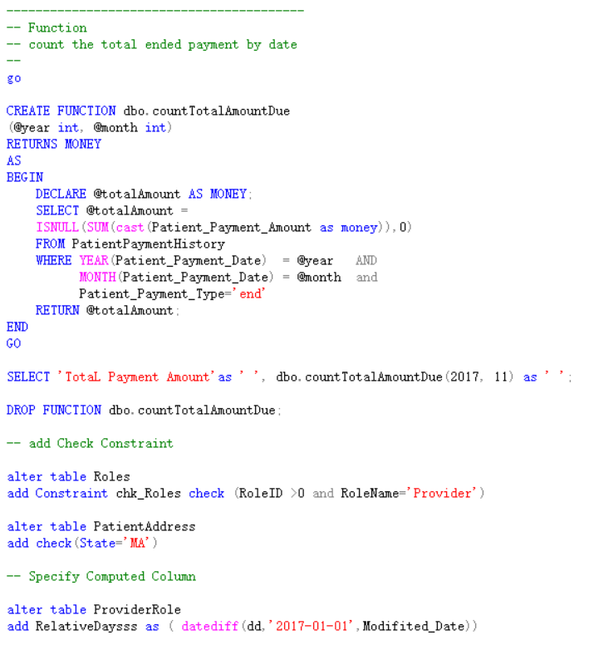
SQL Statements
Function

Slide 15
04
Reporting Views

Slide 16
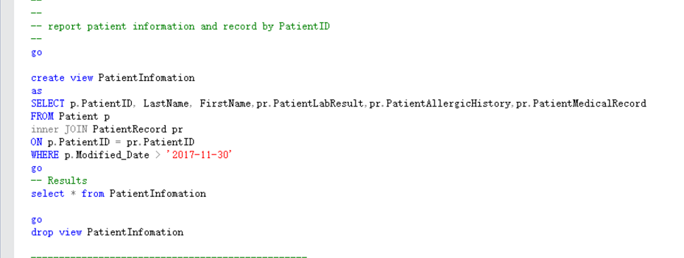
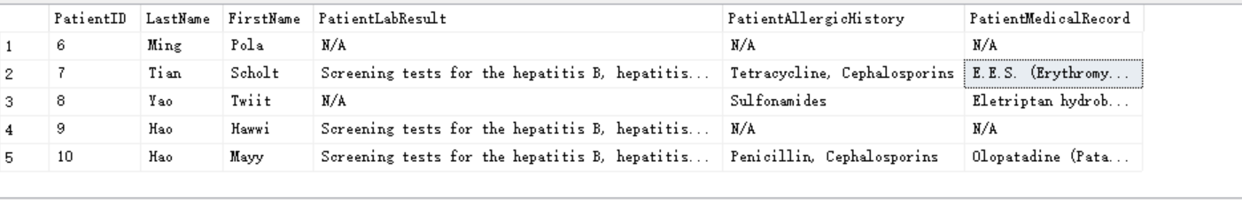
Views
Report patient
information and record
by PatientID
which are modified by date

Slide 17
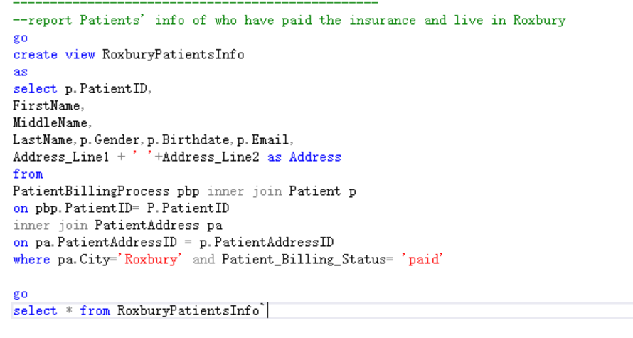
Views
Report patients’
information of who have
paid the insurance
and live in Roxbury

Slide 18
05
PowerBI Report

Slide 19
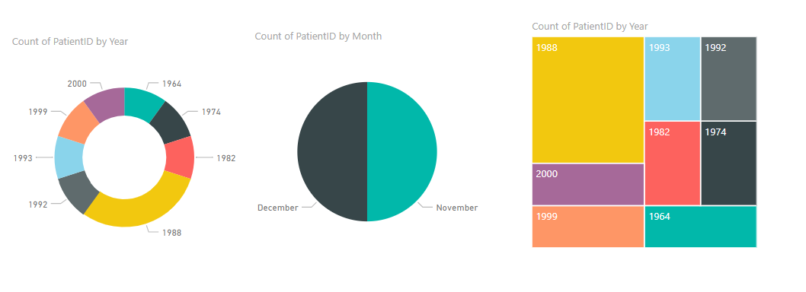
Report
Report the count of patient by birthday and the latest modified date
Report patients’
information of who have
paid the insurance
and live in Roxbury

Slide 20
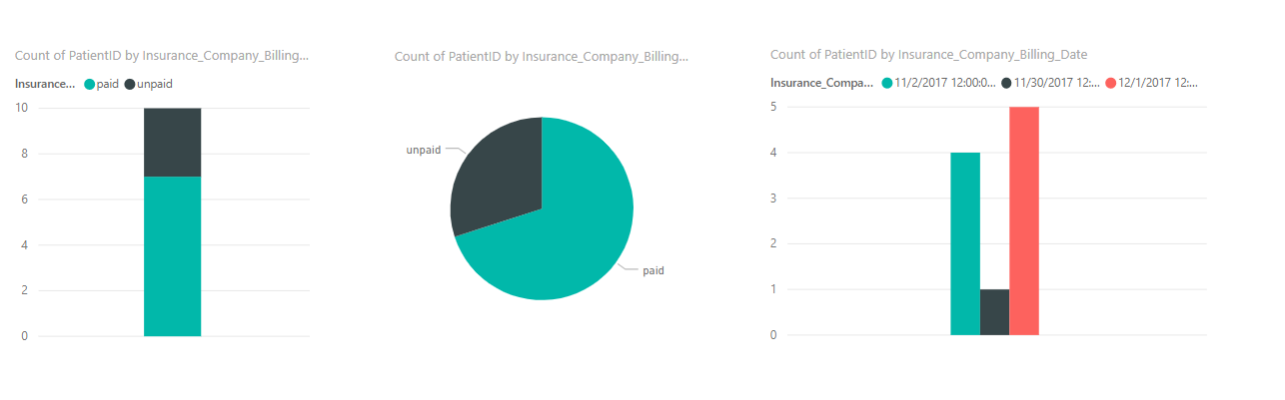
Report
Report the count of patient by the billing status and the billing date
Report patients’
information of who have
paid the insurance
and live in Roxbury

Slide 21
THANK YOU

